Slide 1
Key levels
Fixed Range Volume Profile

Slide 2
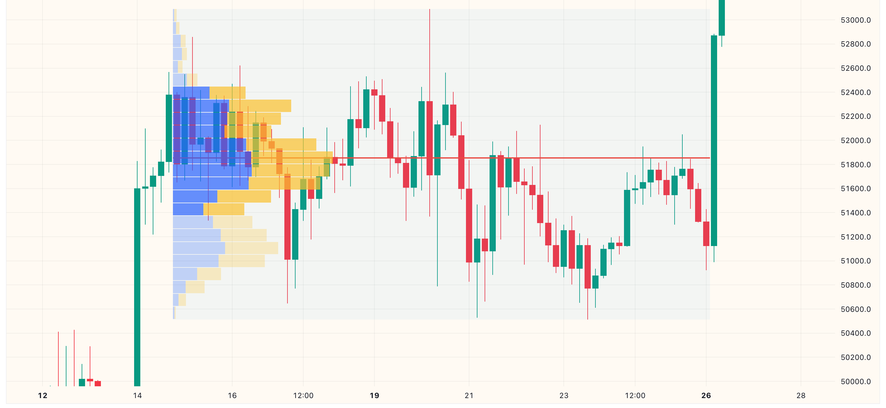
What is Fixed Range Volume Profile (FRVP)
Statistics of volume data within a specific range.
固定范围内的交易量分布数据统计

Slide 3
What we get from FRVP
Point of Control (POC):
Price level with highest traded volume.
量价重心 (POC):
最高成交量的价位

Slide 4
What we get from FRVP
Value Area (VA):
Range of price levels within specific % of traded volume.
VAH: Range High
VAL: Range Low
量价区间 (VA):
特定百分比成交量的价位区间
VAH:区间高点
VAL:区间低点

Slide 5
How to draw FRVP
Select a specific time period.
Set row size (precision)
Set value area volume (%)
选择合适的时间区间
确定价位行数（精度）
确定量价区间宽度（百分比）

Slide 6
What to do with FRVP
Support and Resistance Levels
POC as the core level
VAH and VAL as the boundaries or alerts
支撑和阻力
量价重心作为核心点位
量价区间给出宽容度，并参考预警

Slide 7
Thoughts on Volume Profile
Why Volume Profile?
为什么参考交易量分布数据统计？
Mixed usage with Fibonacci Retracement?
与斐波那契回撤的混合使用？

